Slide 1
Oracle Digital Assistant Insights
Kirk Thacker
March 28, 2022

Slide 2
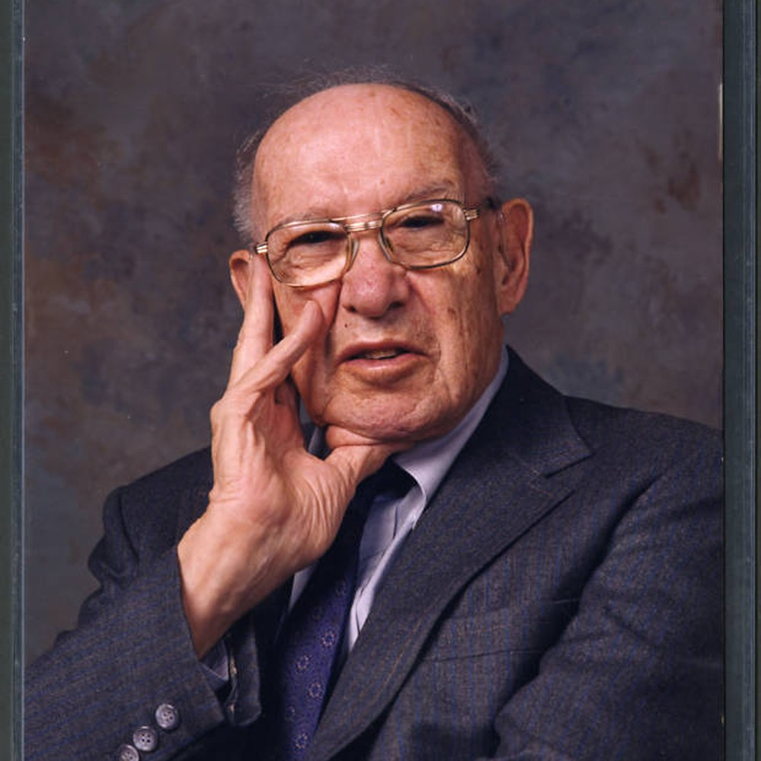

“What Gets Measured Gets Managed”
Peter Drucker
Notes:
There’s a great quote from Peter Drucker that reflects the sentiment “what gets measured gets done.” And our ODA Insights can help you ensure that your digital assistant delivers for you.

Slide 3
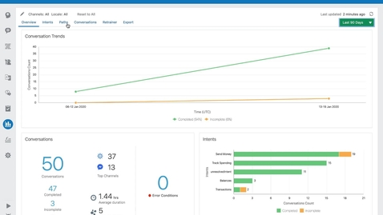


What Are Insights?
Developer-oriented analytics on usage patters for a digital assistant
Reveal number of conversations from a digital assistant
Reveal the popularity of the skills registered to a digital assistant
Tell how often each intent is called, percentage of calls completed, path user takes through the skill
Notes:
So what are insights? The Insights reports offer developer-oriented analytics that pinpoint issues with skills. <Build>>Using these reports, you can address these issues before they cause problems<<BUILD>> They tell the number of conversations, popularity of skills, effectiveness of your skills and the intents they use – and help you correct, train and enable a better experience

Slide 4
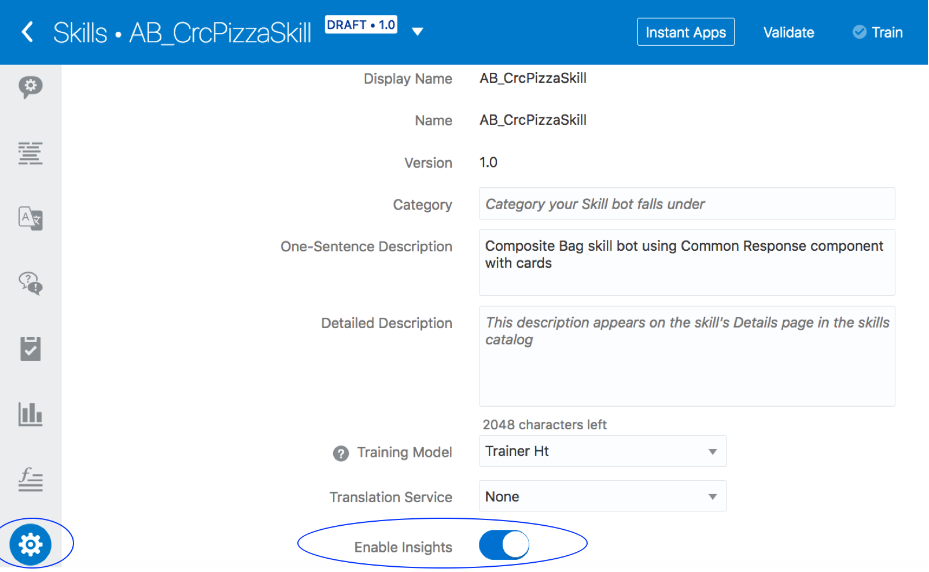
How Do I Enable Insights?
These reports display data when Enable Insights, located in the General page of Settings
Notes:
Here is where you can enable Insights in your ODA environment

Slide 5
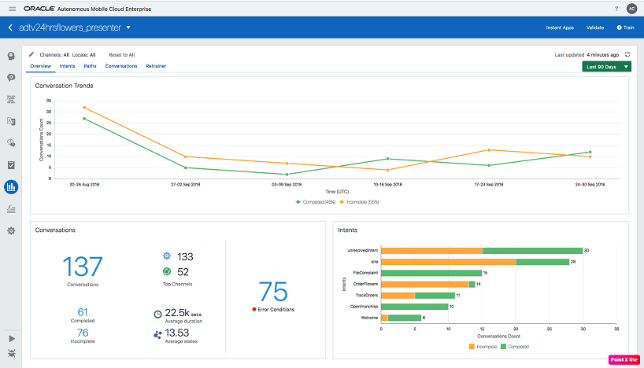
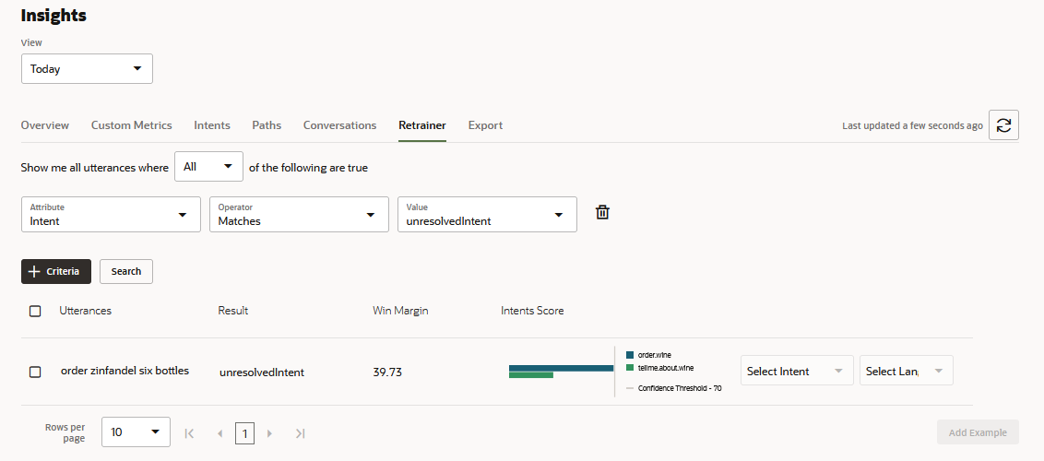
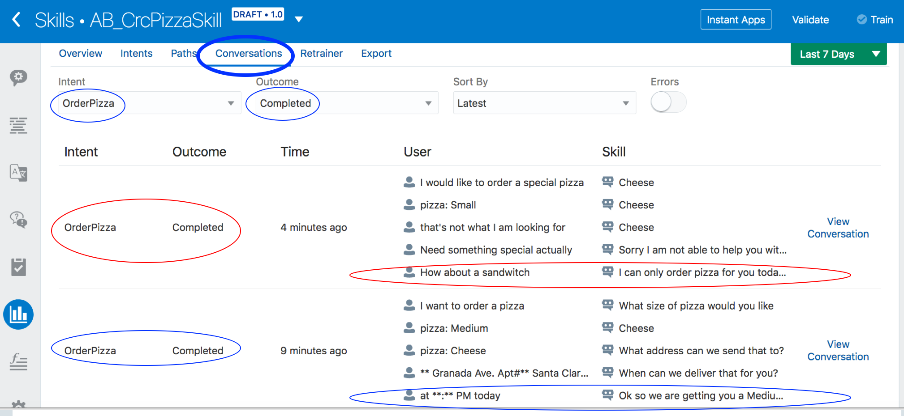
What Types of Reports are Available?
Overview Reports
Skills and Intents
Retrainer
Conversations
Notes:
So what types of reports are available? We have Overview reports – they give you the big picture of what is happening. CONVERSATION reports Displays the transcripts for the conversations that occurred during a session to give insight into action – SKILLS - digital assistant's skill routing and intent resolution can be evaluated. RETRAINER - the counterpart to the skill-level Retrainer, lets you improve the intent resolution for the registered skills using the live data that flows through the digital assistant

Slide 6
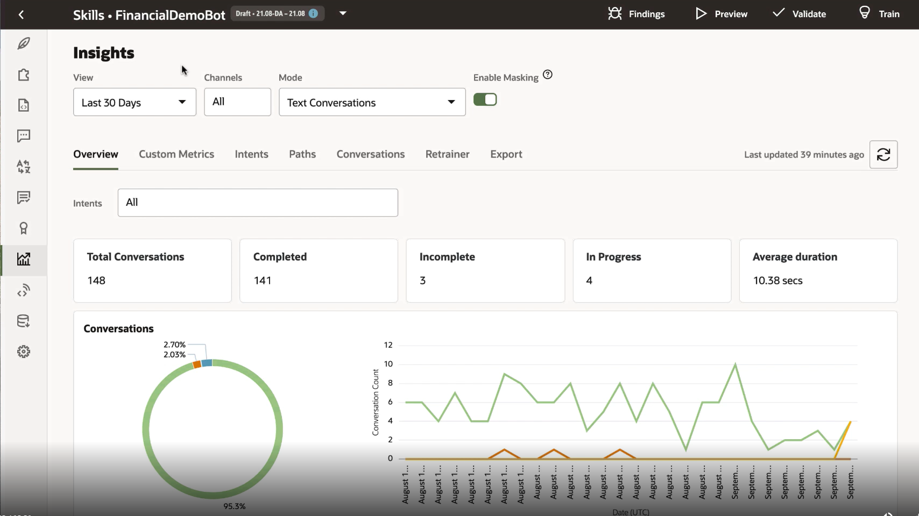
Overview Metrics and Graphs
Use this dashboard to quickly find out the total number of voice and text conversations by channel and by time period. The report's metrics break this total down by the number of complete, incomplete, and in-progress conversations. In addition, this report tells you how the skill completed, or failed to complete, conversations by ranking the usage of the skill's transactional and answer intents in bar charts and word clouds.
Notes:
One area of reporting are our Overview Reports. This dashboard consists of a number of reports that give you the big picture of how things are going - # of conversations, % competed, how long and more. It combines charts and tiles to keep you abreast of your world

Slide 7
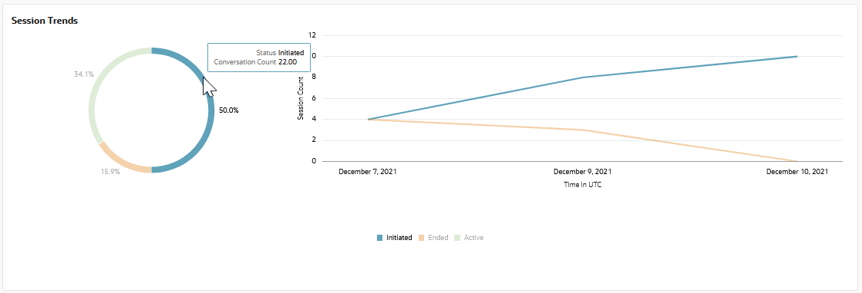
Session Trends
As a donut chart, which contrasts the total number of sessions that have been initiated against the sessions that have ended or remain active. You can find out the actual count by clicking the arcs. As a trend line that plots the count of active, ended, and initiated session against dates.
Notes:
Here are some of the reports that make up this dashboard. I can monitor these trends. Using a donut chart

Slide 8
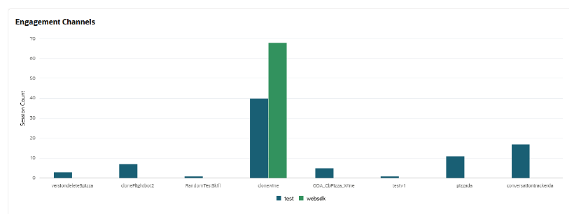
Engagement Channels
A clustered bar chart plotting the number of sessions initiated through a channel that's connected to a skill or digital assistant.
Notes:
I can understand the number of sessions initiated through a channel connected to a skill or digital assistant

Slide 9
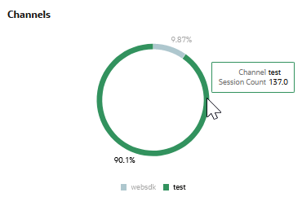
Channels Donut Chart
The different arcs of chart track channel usage as a percentage of the total sessions for a specified time. In this illustration, a cursor hovers an arc, revealing the actual number of sessions.
Notes:
This chart tracks channel usage as a percentage of the total sessions. Hovering on it lets me see details.

Slide 10
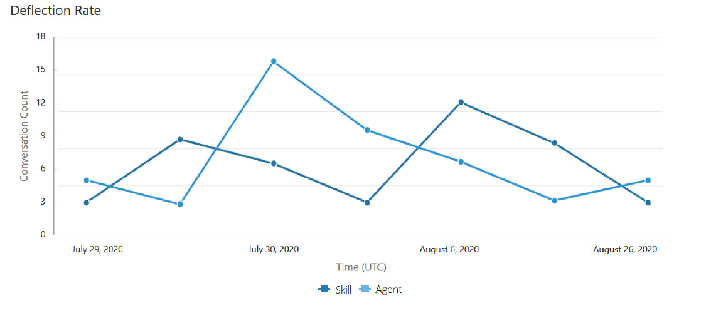
Deflection Rate Report
For skills integrated with live agents through B2C Service Chat and B2B Service Chat, you can use this report to track the number of conversations that were completed because skills, not human agents, answered customer questions or fulfilled customer requests.
Notes:
If you integrate ODA with one of our Service products you can evaluate the number of conversations completed due to skills, not human agents (note “Agent” in this report refers to a human being)

Slide 11
Aggregate Performance
You can view performance trends through the Aggregate view's stacked area chart. It contrasts the completed conversations for the period against conversations that customers couldn’t complete because of unresolved intents (or other problems) and the conversations that remained incomplete because they were abandoned by customers.
Notes:
You can view performance trends through this stacked area chart. It compares completed conversations vs incomplete tracked over time.

Slide 12
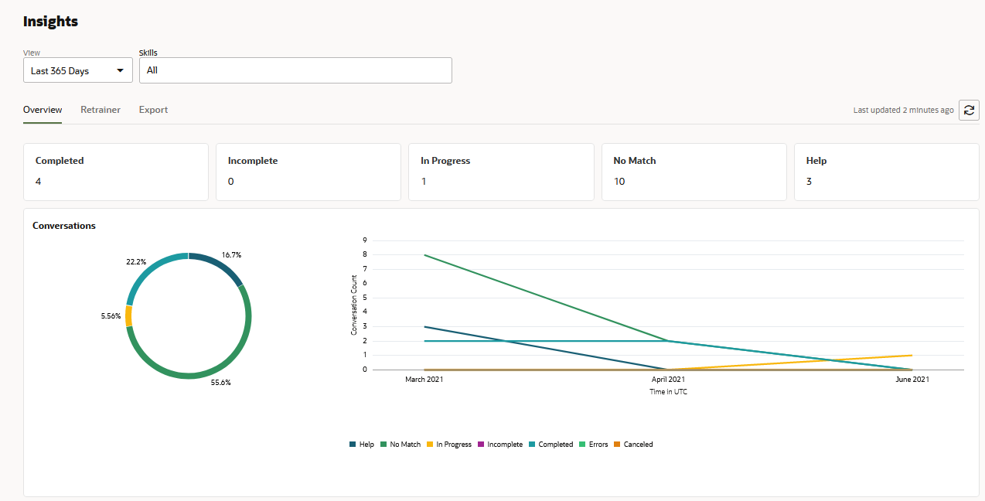
Total Conversations
On the left side is Status and Count. There are counts for Completed, Errors, In Progress, and Unresolved. On the right is a graph showing the number completed conversations and other conversations over a period of 30 days.
Notes:
You can details for Total conversations

Slide 13
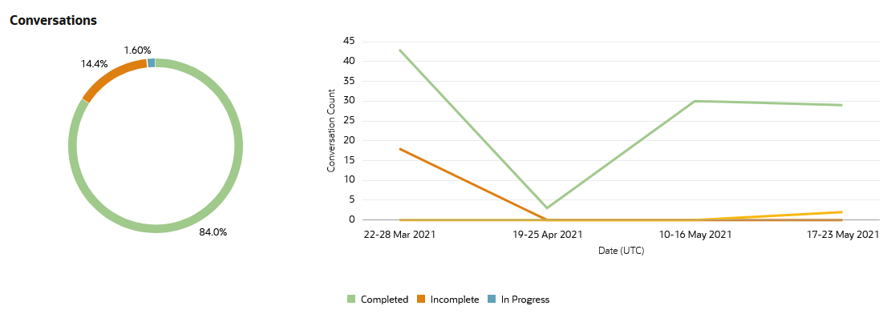
Conversation Trends
The Conversation Trends chart plots the following for transactional intents (including agent transfer intents) and answer intents: Completed, Incomplete, In Progress.
Notes:
Look at how conversation have been trending over time

Slide 14
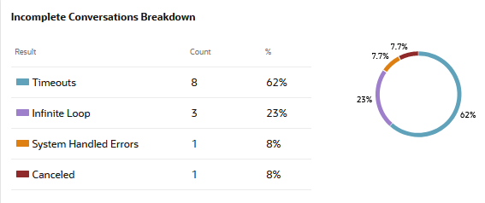
Conversation Breakdown Chart
The error categories of Infinite Loops, System-Handled Errors, and Timeouts are represented individually as a segmented circle chart.
Notes:
Get a breakdown of Incomplete conversations and understand why they did not complete

Slide 15
Conversations Across Skills
This report returns key performance indicators (KPIs) for skills that are currently in production for given period. These metrics are aggregated across all versions of the skills.
Notes:
I can also evaluate effectiveness of the various skills I have deployed. Are my conversations completing successfully with the skills associated with utterances?

Slide 16
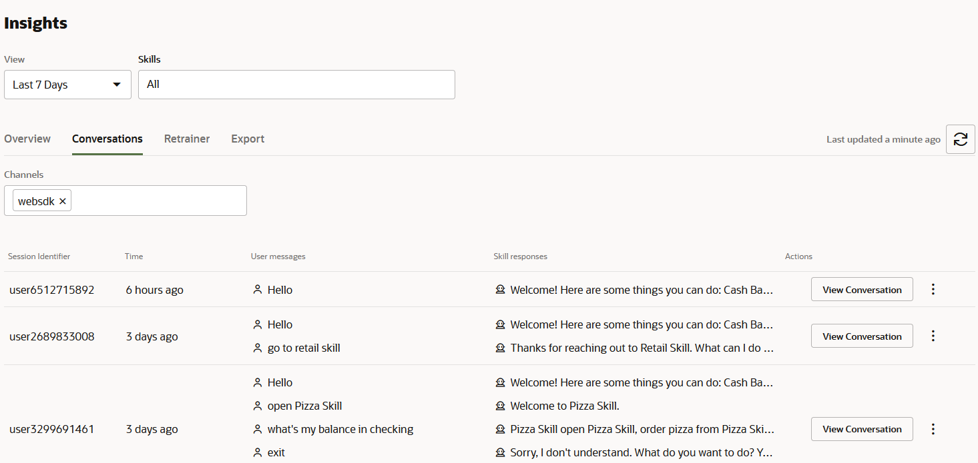
Conversation Report
This report has two filters, which are located at the top right: View (for date filtering) and Skills. Beneath these filters in the Channels filter. The report displays the returned conversations in a table that has, from left to right, the following columns: Session Identifier, Time, User messages, Skill responses, Actions (where the View Conversation option is located).
Notes:
I can get into details of the conversations that happen going from this high level summary that I can filter with date range and/or skill go see the very detail of what was asked/said

Slide 17
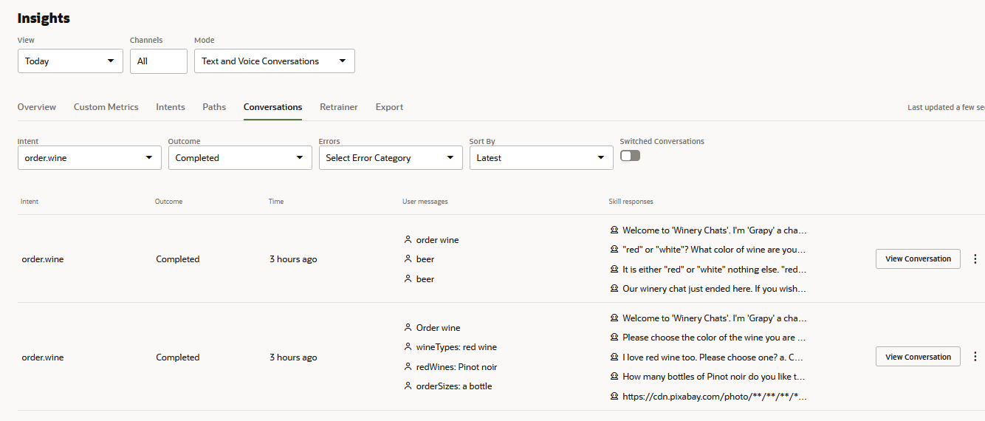
Completed Conversations Report
You can read transcripts of the completed conversations for an intent.
Notes:
I can view this by Conversations that Completed

Slide 18
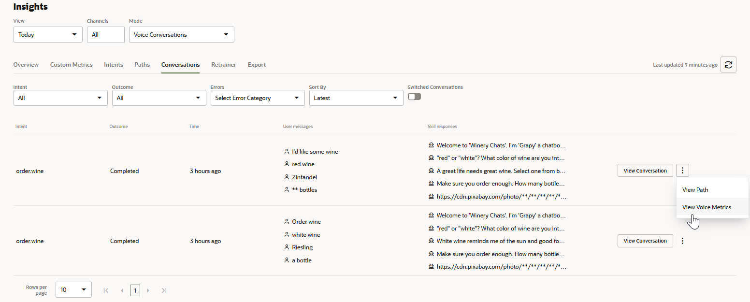
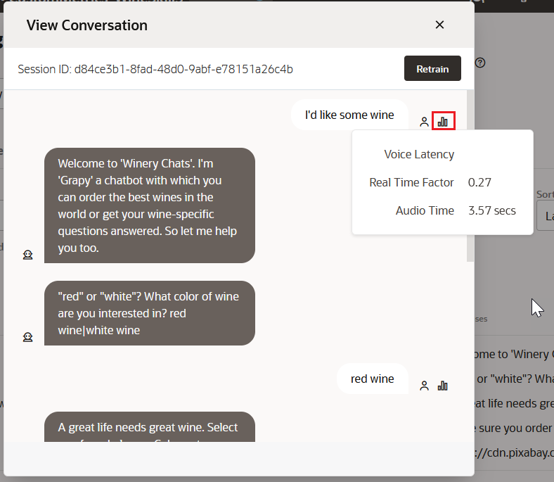
View Conversation Transcripts With Voice
Clicking View opens the conversation in the context of a chat window. Clicking the bar chart icon displays the voice metrics for that interaction. Clicking View Voice Metrics displays a subset of the voice metrics that are averaged across the entire conversation.
Notes:
And also click to see the context including voice metrics

Slide 19
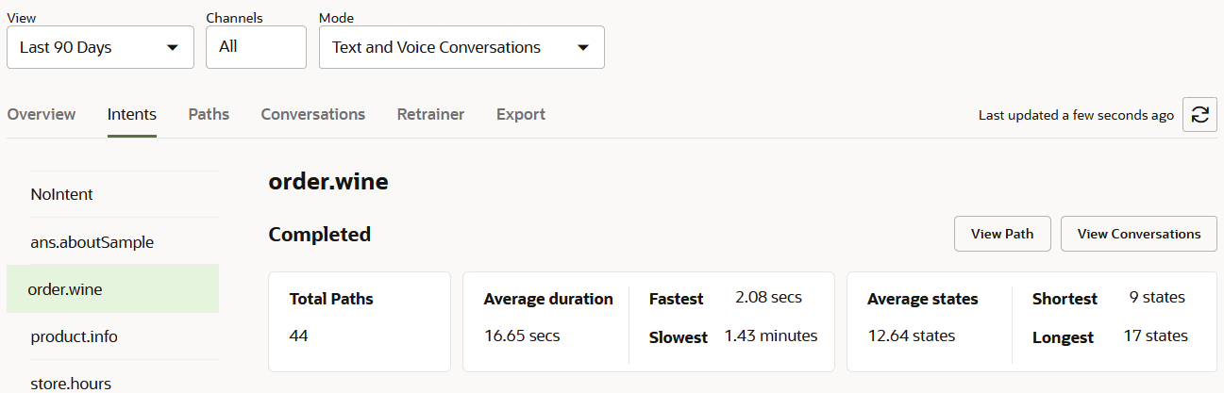
Completed Paths Report
For completed conversations, the report tells you the number of execution paths that users traversed to complete these conversations with statistics on the time spent and the number of states visited.
Notes:
For the conversations that complete, I can gain insight into the execution paths that users traversed. I can see statistics on time spent and number of states visited. I can click on the “View Path”

Slide 20
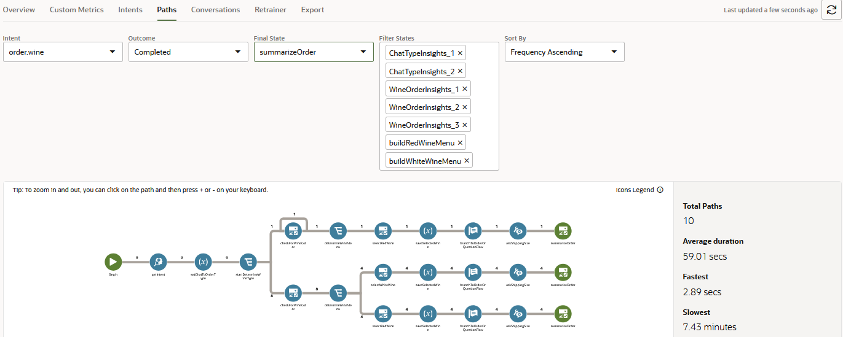
Complete Conversations View Path Report
This is an image of the Path report as accessed from the complete conversations: the report is filtered by the intent selected in the Intents report and by the Completed outcome.
Notes:
For the conversations that complete, I can gain insight into the execution paths that users traversed. I can see statistics on time spent and number of states visited. I can click on the “View Path”

Slide 21
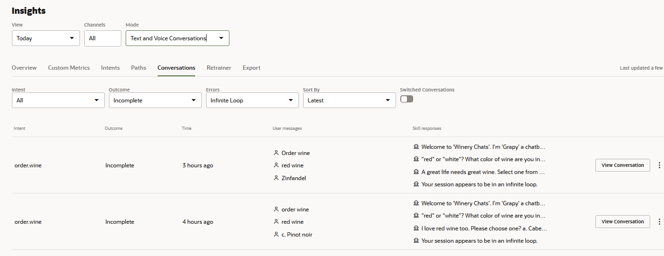
Incomplete Conversations Report
Conversations that users didn't complete, because they abandoned the skill, or couldn't complete because of system-level errors, timeouts, or flaws in the skill's design.
Notes:
I can also see and understand which conversations did NOT complete. I can see why – they abandoned the skill, had a system error, timeout or perhaps a flaw in the design of the skill

Slide 22
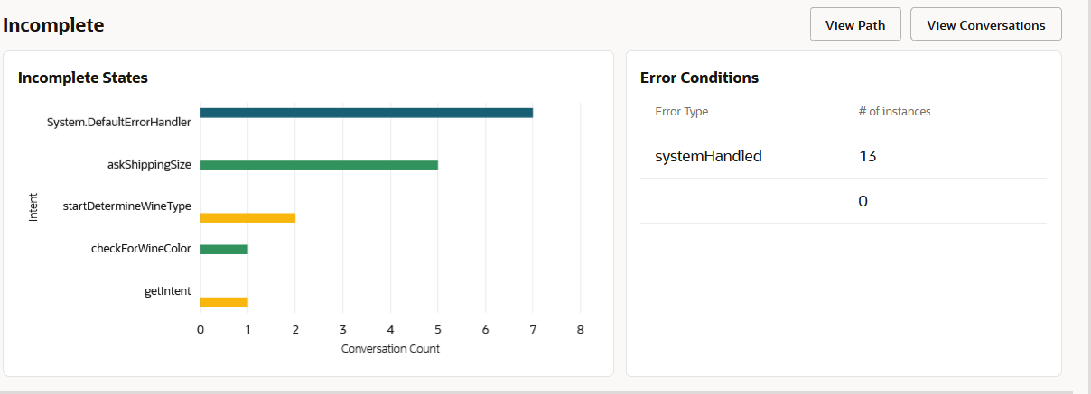
Incomplete Paths Report
For the incomplete conversations, you can identify the states along the intent's execution path where these conversations ended using the Incomplete States horizontal bar chart.
Notes:
With the incomplete conversation is this report that lets me identify the states along the intent’s execution path where the conversation ended. I see it depicted in bar chart form. And of course I can click on “View Path” to better understand

Slide 23
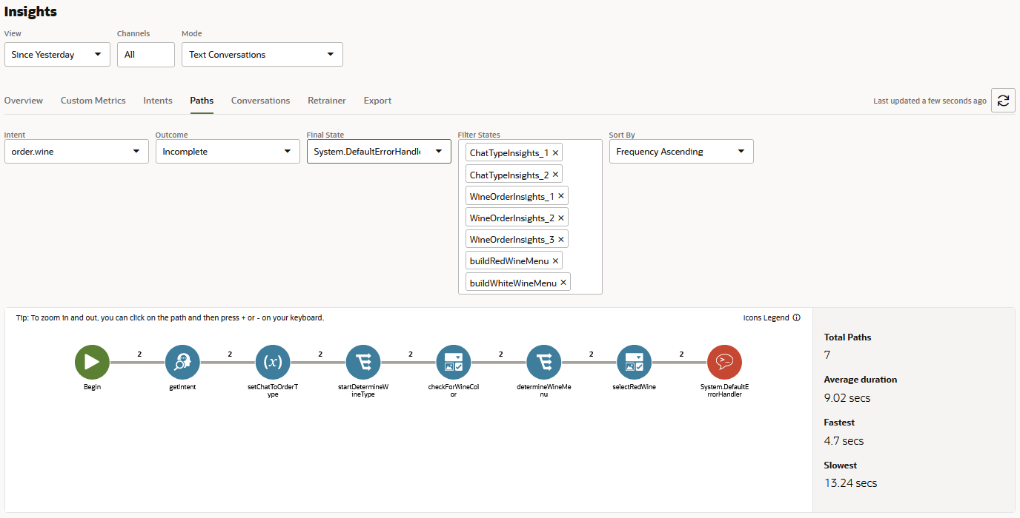
Incomplete Conversations View Path Report
This Path report is accessed from the incomplete conversations: the report is filtered by the intent selected in the Intents report and by the incomplete outcome.
Notes:
And I am brought here to get details of this particular intent

Slide 24
Languages Report
The Languages chart is found in the overview page for digital assistant-level Insights. It is a stacked bar chart. The Y axis is the number of Conversation. The X axis are bars for each skill. The bars are segmented by language.
Notes:
This is also a report found on the overview dashboard for Insights. The stacked bar chart shows skills by language by the number of conversations

Slide 25
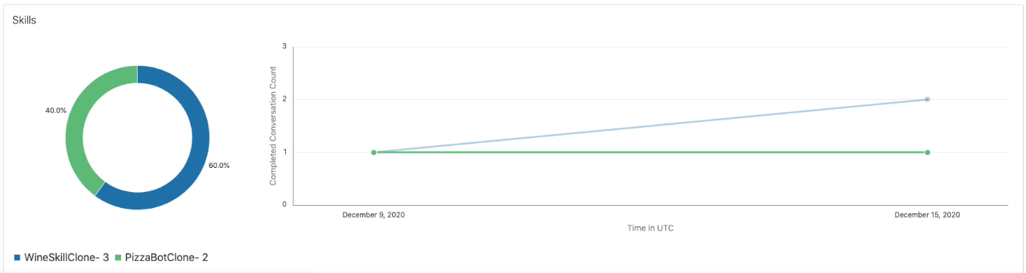
Skills Trends
On the left side is a pie chart showing the percentages of conversations that use each skill. On the right is a graph showing the number completed conversations for each skill over a period of 30 days.
Notes:
Shows a pie chart with the percentage of conversations the use the skill. You can also see a graph depicting the number of completed conversations for each skill over the last 30 days.

Slide 26
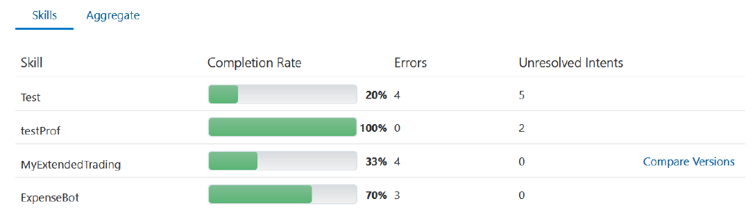
Individual Skills
Use this report to find out how the individual skills compare to one another in terms of the completion rate, the number completed conversations taken against the total conversations for the period. The report includes other factors that influence the skill’s performance during this period: the number of errors (system-handled errors, infinite loops, timeouts) and unresolved intents.
Notes:
You can compare skills to one another using metrics such as completion rate, the number of completed conversations, # of errors, unresolved intents. You can drill down on the bar chart

Slide 27
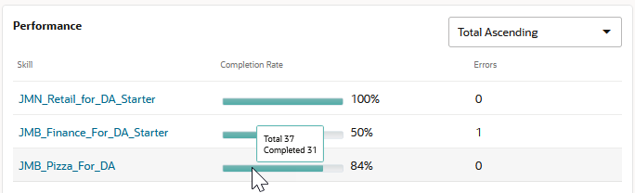
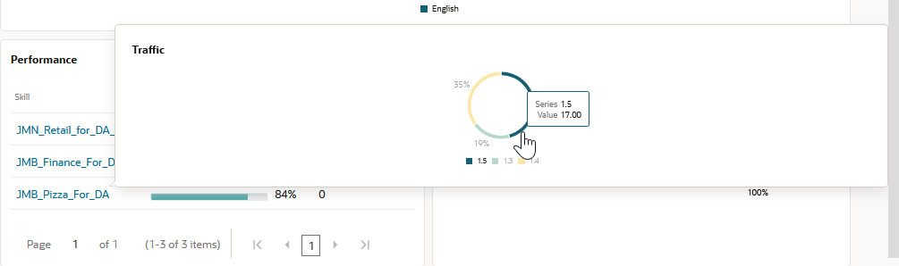
Insight Skills Summary
The Performance section includes a table for the skills. Each row is for a skill (represented as a hyperlink) and each row contains a horizontal bar chart for the overall conversations handled by the skill for a given period. In this screen capture, the hover text for one of the charts is displayed. It tells you the total conversations for the skill and the completed number of conversation for the skill. If the hyperlink for a skill is selected, which opens a pop-up window that contains the Traffic chart for the selected skill. This is a circular chart, with each segment representing a version of the skill. The lengths of the arcs and their accompanying percentages tell you about the volume of conversations handled by each version in terms of the total number of conversations for the skill for a given period.
Notes:
When you do, you will see the Skill Summary – the popup window contains the traffic chart for the skill. The circle chart has segments representing a version of the skill. It will tell you the volume of conversation handled by each version of the skill.

Slide 28
Compare Metrics Across Skill Versions
To compare how different versions have impacted the success of a skill, click Compare Conversations in the Skills report to open the dialog.
Notes:
Speaking of looking at different versions of the skill, you can look at this in this report viewing it by different metrics such as completion rate, unresolved count and more. You can filter this by time as well.

Slide 29
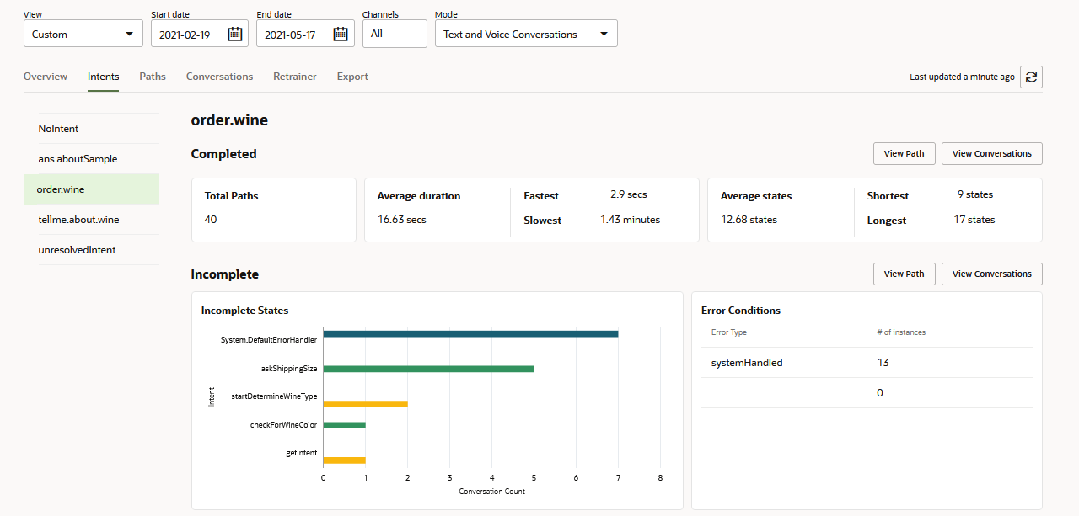
Review Intents Report
You can find out the total number of complete and incomplete conversations for each intent in the Overview report. Using the Intents report, you can find out how the user traffic flowed along the intents' execution paths and where it was blocked by malfunctioning states.
Notes:
You can evaluate how each of your intents are doing gauging the number of complete conversations by intent, average duration, average number of states and more

Slide 30
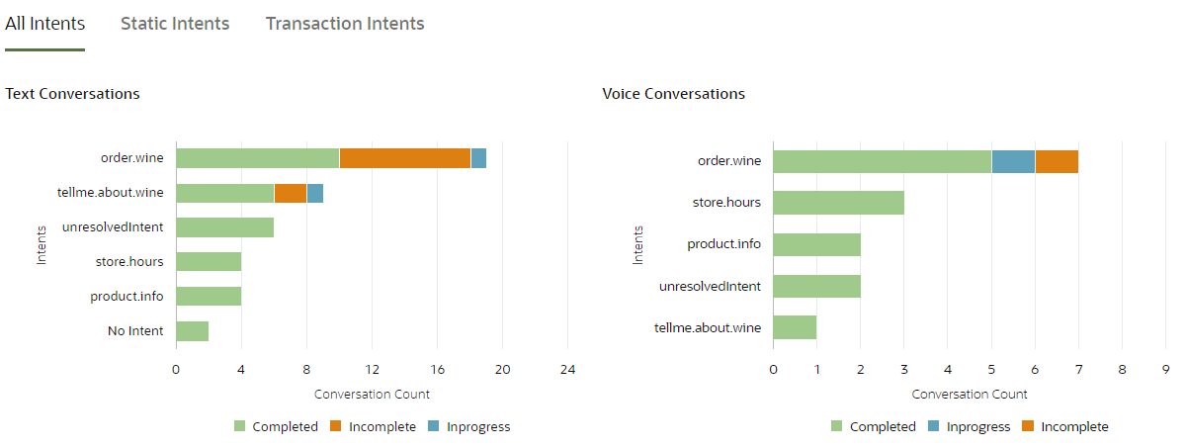
View Intent Usage
The Intents bar chart enables you to spot not only the transactional and answer intents that completed conversations, but also the ones that caused incomplete conversations. You can also use this chart to find out if the overall usage of these intents bears out your use case. For example, does the number of completed conversations for an intent that serves a secondary purpose outpace the number of completed conversations for your primary intent?
Notes:
This bar chart helps you spot the transactional and answer intents for both completed and incomplete conversations. It can also tell you determine if the overall usage of the intent bears out your use case.

Slide 31
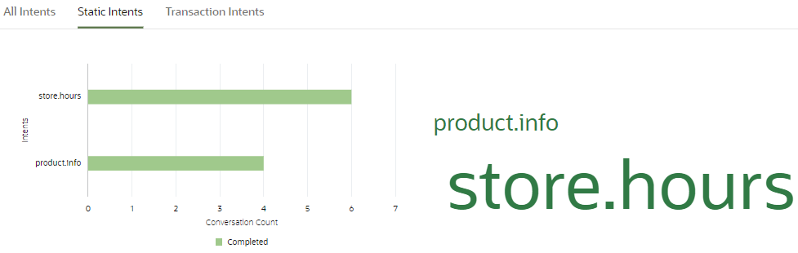
View Intent Usage – Static Word Cloud
The Intents bar chart has three views: All Intents, Answer Intents (selected in this image), Transaction intents. Because Answer (Static) Intents is selected, the word cloud contains the key phrases for the answer intents only.
Notes:
This bar chart has 3 views – Answer intents (this view) contains the word cloud for the key phrases for the answer intents only.

Slide 32
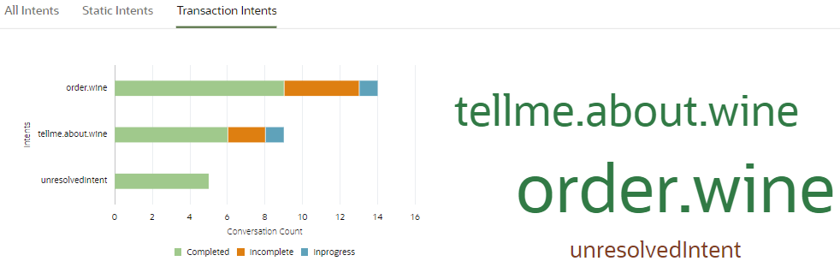
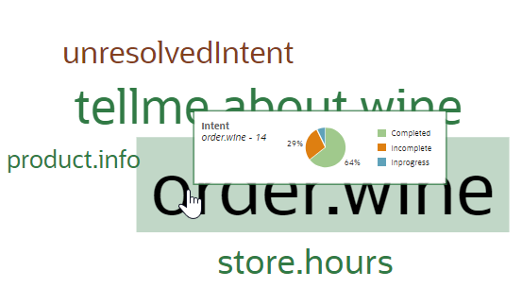
View Intent Usage – Transaction Word Cloud
This is the Intents bar chart popular word cloud in the Overview report. Because Transaction Intents is selected, the word cloud contains the key phrases for the transactional intents only. The Most Popular Intents word cloud provides a companion view to the Intents bar chart by displaying the number of completed and incomplete conversations for an intent.
Notes:
This bar chart is part of an overview dashboard. It focuses on Transactional Intents. It will show a companion view to display the number of completed and incomplete conversations for the intent.

Slide 33
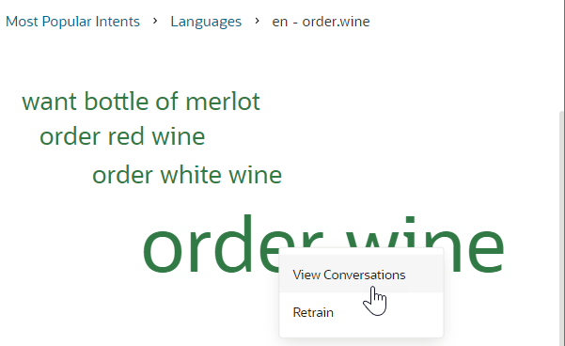
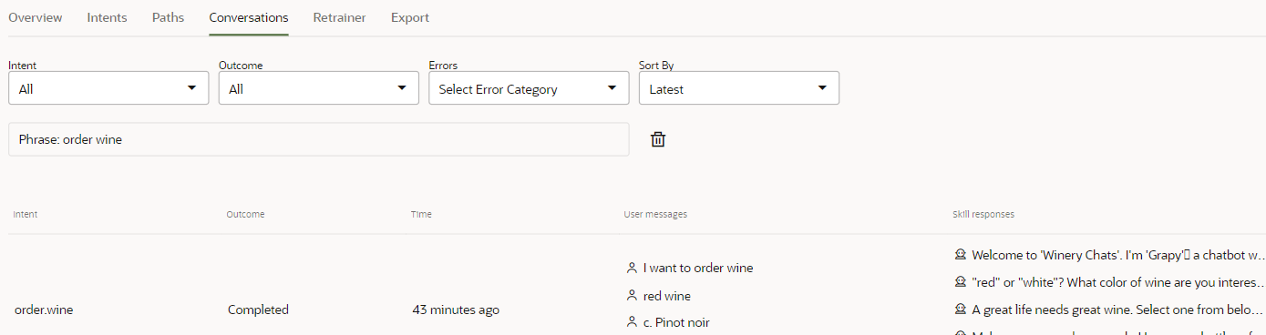
View Intent Usage – View Conversations
You can see the actual user message (or the messages grouped within a key phrase) within the context of a conversation when you click a phrase and then choose View Conversations from the context menu.
Notes:
With this report you can see the actual user messages within the context of the conversation when you pick “View Conversations” – this can produce “Insight to Action” as we will see

Slide 34
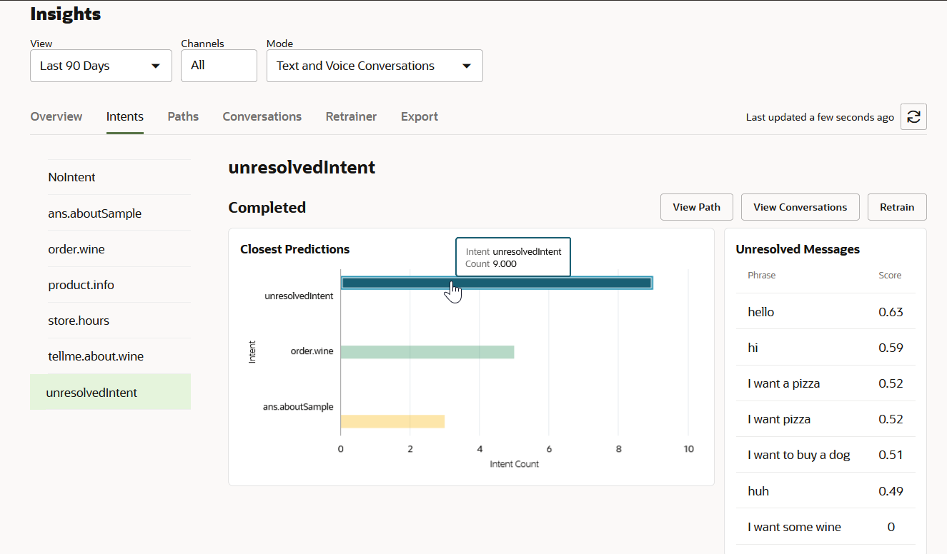
Unresolved Intents Report
This report shows Closest Predictions: A horizontal bar chart. The intents are on the y axis, and the intent count is on the x axis. Top Unresolved Messages (directly to the right of the Closest Predictions pane): Ranks the messages using the Phrase and Score columns.
Notes:
The report shows unresolved intents and the Closest predictions for resolving the intent. This can help you quickly improve the digital assistant experience.

Slide 35
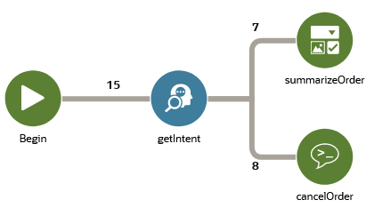
Review Path Insight Report
The Paths report lets you find out how many conversations flowed through the intents' execution paths for any given period. This report renders a path that's similar to a transit map where the stops can represent intents, the states defined in the dialog flow definition and the internal states that mark the beginning and end of every conversation that is not classified as in-progress.
Notes:
This report lets you find out how many conversations flowed through the intents' execution paths for any given period. It is like a transit map where stops can represent intents, states defined in the flow and internal states to mark the beginning and end of the conversation.

Slide 36
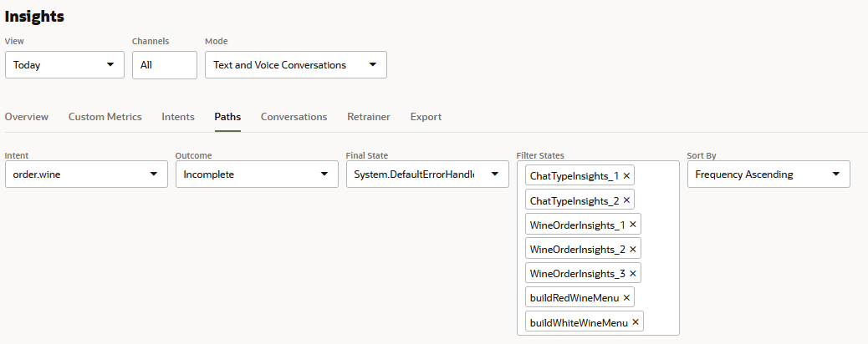
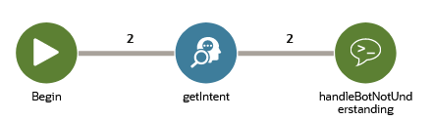
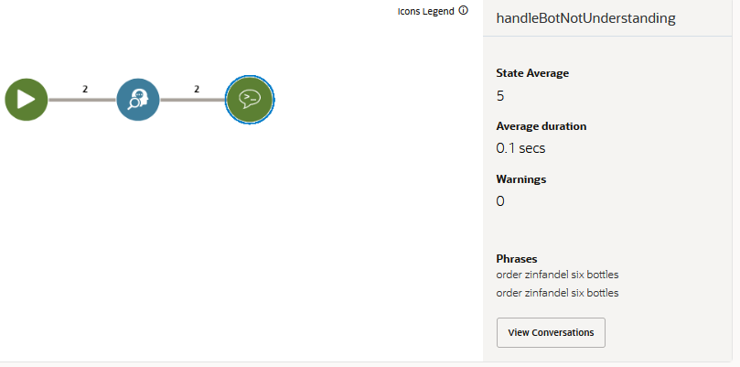
Query the Paths Report
Clicking the final state opens the details panel, which displays statistics, errors, warnings and the final user messages.
The Paths report renders an intent execution path according to your query parameters. You can query this report for both the complete and incomplete execution paths for any or all intents, set the length of the path by choosing a final state, and isolate portions of the execution paths by excluding states that are of secondary importance.
Notes:
You can query an intent and find its execution path based on the parameters it was given. The report will relay the corresponding metrics for the path.

Slide 37
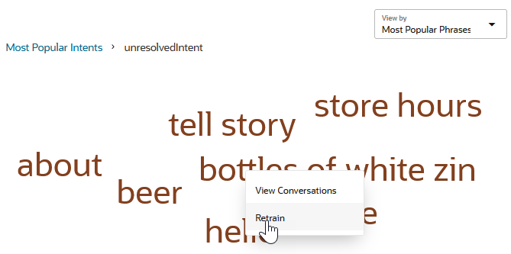
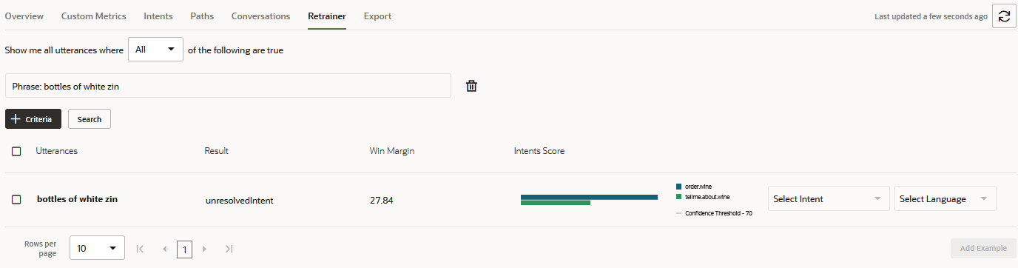
View Intent Usage – Retrain Unresolved Phrases
You can see the actual user message (or the messages grouped within a key phrase) within the context of a conversation when you click a phrase and then choose View Conversations from the context menu.
Notes:
You can see what utterances are not tied to an intent. And you can then use the Retrainer capability to SOLVE for this! Another excellent example of “Insight to Action”

Slide 38
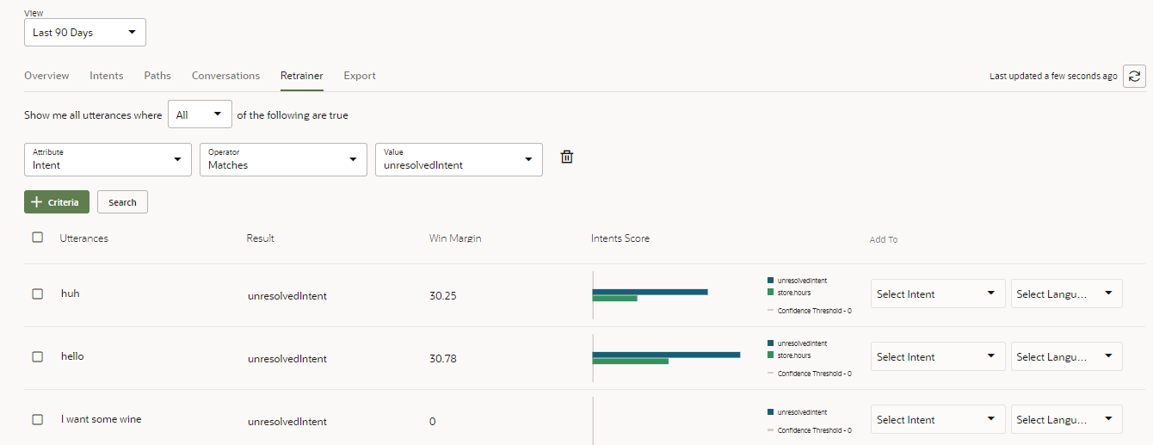
Retrainer Report – Access from Unresolved Intents
The Retrainer report can be accessed from the Intents report for unresolved intents. In this mode, the report is filtered by intent and unresolved.
Notes:
It brings you to this screen where I can now associate This unresolved utterance with an existing Intent OR create a new Intent

Slide 39
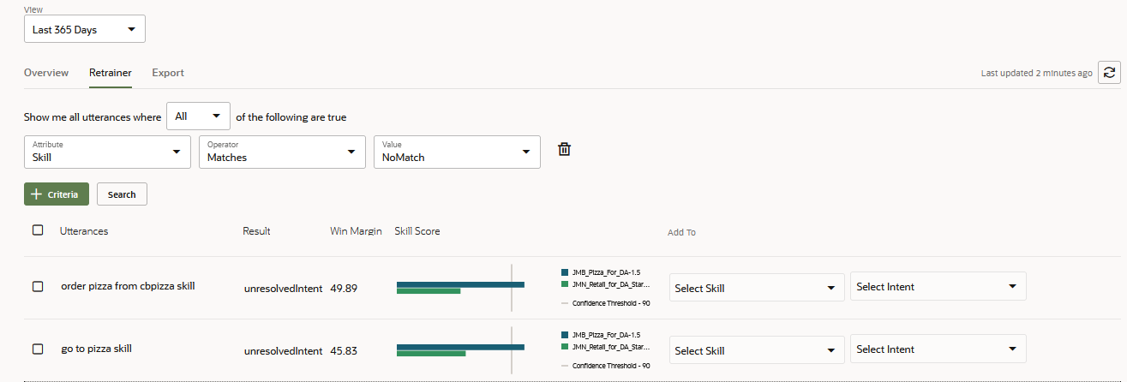
Retrainer Report
The results are filtered by skill. You can improve the intent resolution for the registered skills by updating their training data with customer input. Some of this input may not have been resolved to any skill, or it may have been routed to the wrong skill. The Retrainer helps you evaluate this user input and add it to a skill if you consider it a useful addition to the training data
Notes:
This report can also be accessed apart from Unresolved Intents.

Slide 40
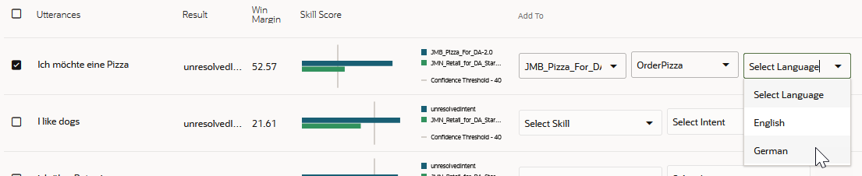
Retrainer Report – Multi-language Skill
These skills have an additional option, a Languages menu, which is a drop-down list of the natively support languages for the skill.
Notes:
From the retrainer report, you can specify a language for your skills as well.

Slide 41
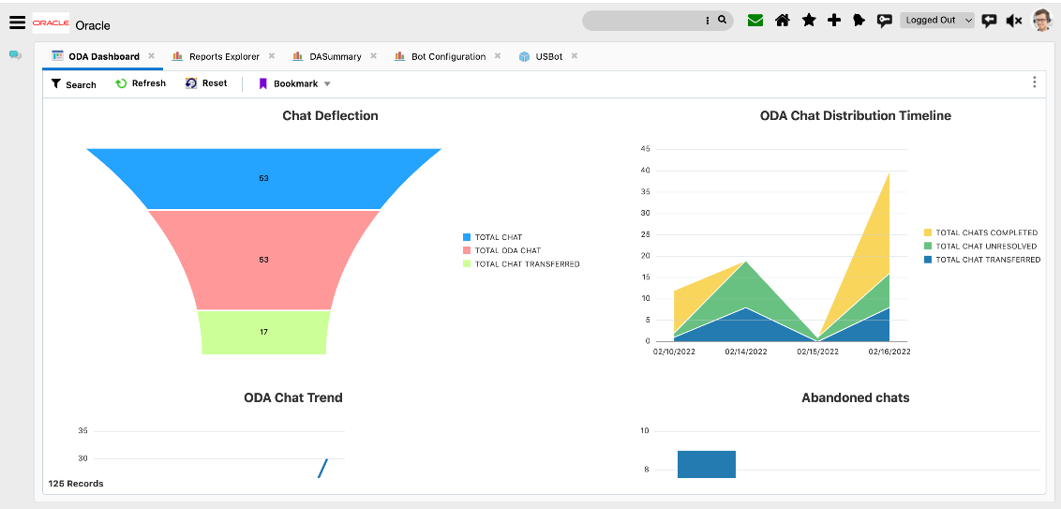
ODA as an Agent in Service Cloud – Chat Deflection
Notes:
If your Digital assistant is tied to one of our service clouds, Service Cloud’s native reporting can let you know how the digital assistant is doing as a “Virtual Agent”

Slide 42
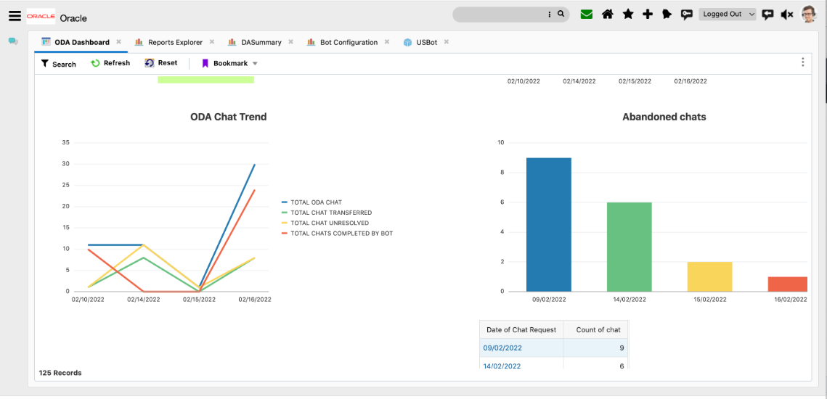
ODA as an Agent in Service Cloud – Chat Abandonment
Notes:
Another example of the same in Service Cloud shows chat statistics handled by ODA

Slide 43

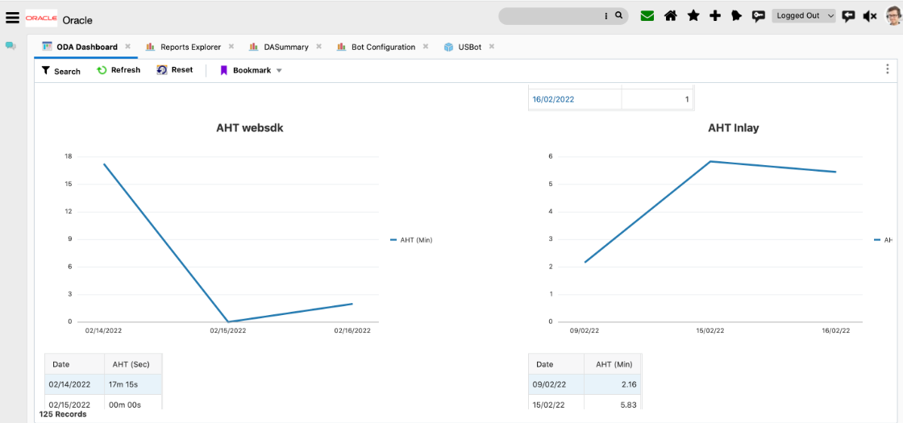
ODA as an Agent in Service Cloud – Average Handle Time
Thank you!

